Slide 1
Safety in the Science Lab

Slide 2

Rule #1: NO fooling around!
ALWAYS follow directions.
LISTEN to your teacher.
RESPECT those around you.

Slide 3

Rule #2: Do not eat or drink in the lab!
There are chemicals in a lab that can be on the table tops.
Never eat or drink in the lab to prevent yourself from coming in contact with dangerous substances!

Slide 4
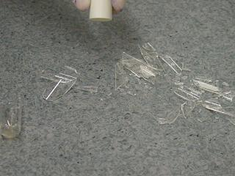
Rule #3: Report any accidents
If a glass breaks or a chemical spills, you must report it to the teacher.
Never cover up a chemical spill.
Never try to clean a chemical spill.

Slide 5
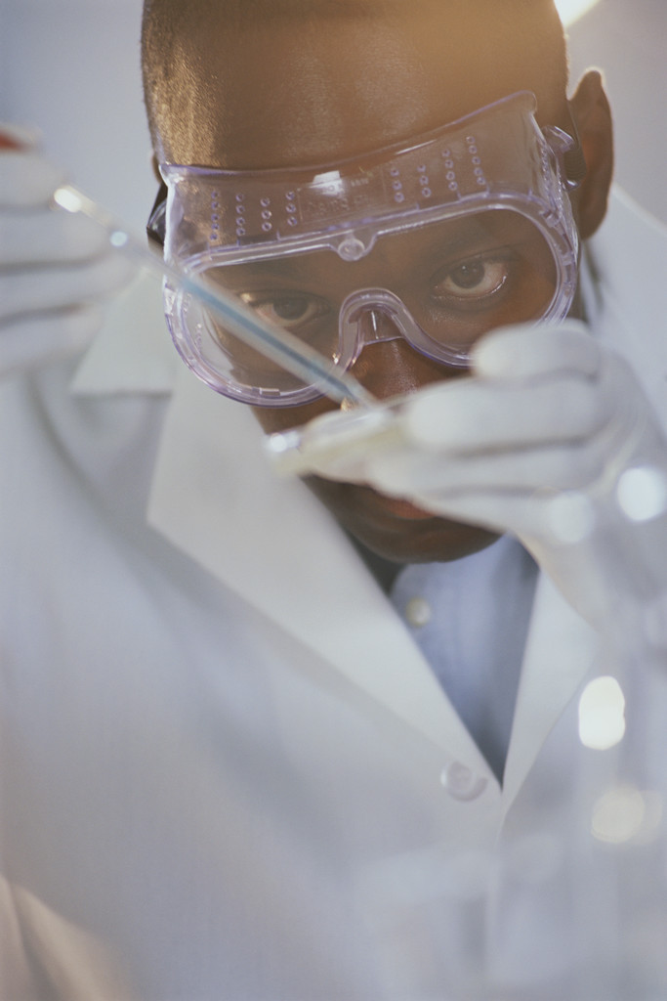
Rule #4: Use your safety gear!
Wear your lab apron, safety glasses or goggles and gloves when needed.
You may not perform an experiment without the proper safety equipment.

Slide 6
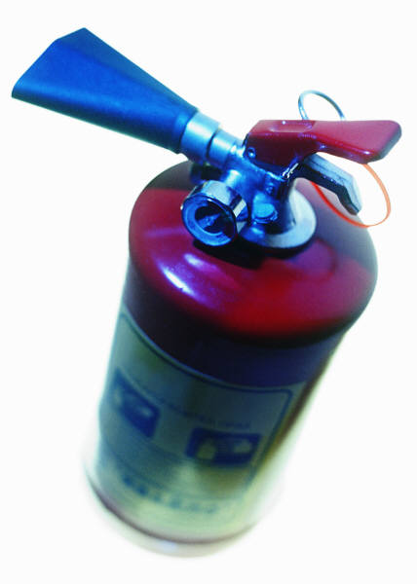
Rule #5: Know location of safety materials!
Learn the location of the:
Eyewash
Fire extinguisher
Fire blanket
Safety hood
Chemical spill kit
First aid kit

Slide 7
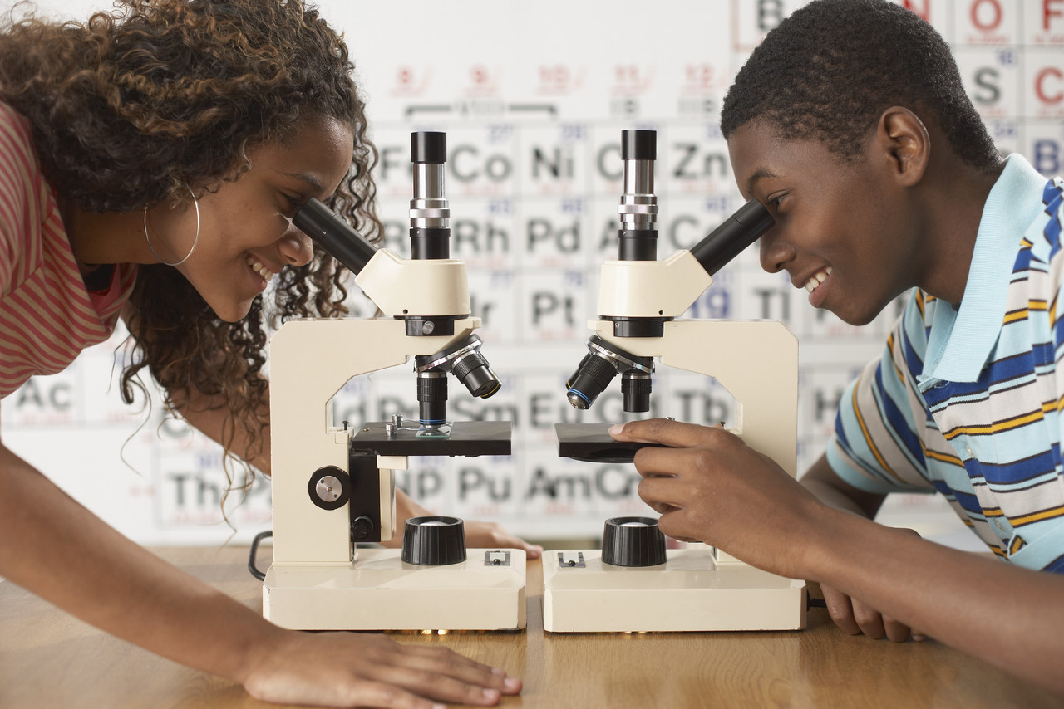
Rule #6: Respect your classmates!
Work in a lab requires teamwork. Every person in this room is worthy of respect. Treat each other with a mutual respect.

Slide 8

Rule #7: Read!
It is very important to look over the lab experiment handout before coming to class.
If you don’t know what you are doing you will have a hard time executing the experiment.

Slide 9

Rule #8: Ask a question!
If you don’t understand ASK!
If it still isn’t clear…ASK again!
Never be afraid to ask a question before you perform an experiment or during an experiment.

Slide 10

Rule #9: Clean up!
You are responsible for your work area.
Keep it clean during and after the experiment.
Everyone is responsible for cleaning up their experiment and putting things away at the end of the lab.

Slide 11
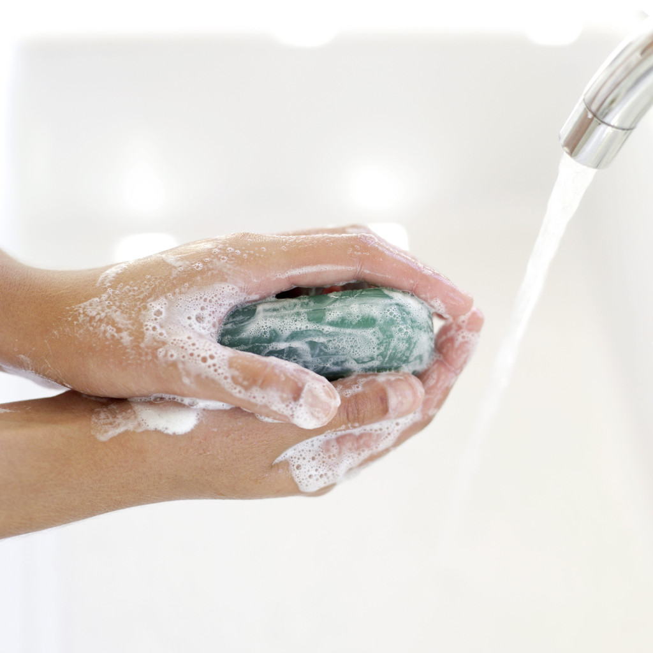
Rule #10: Wash your hands!
Even if you wore gloves you must wash your hands at the end of every experiment.

